Slide 1
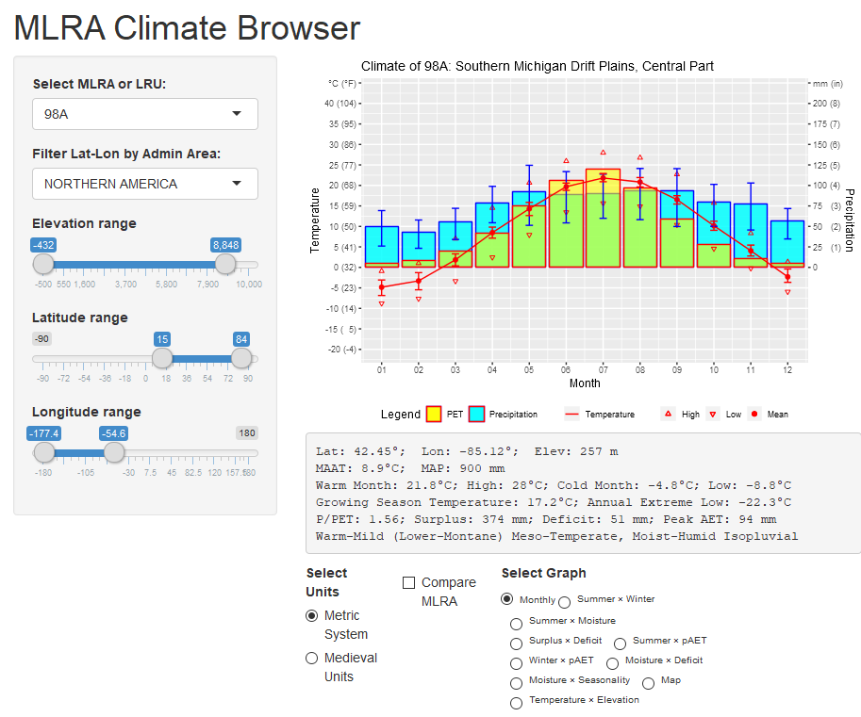
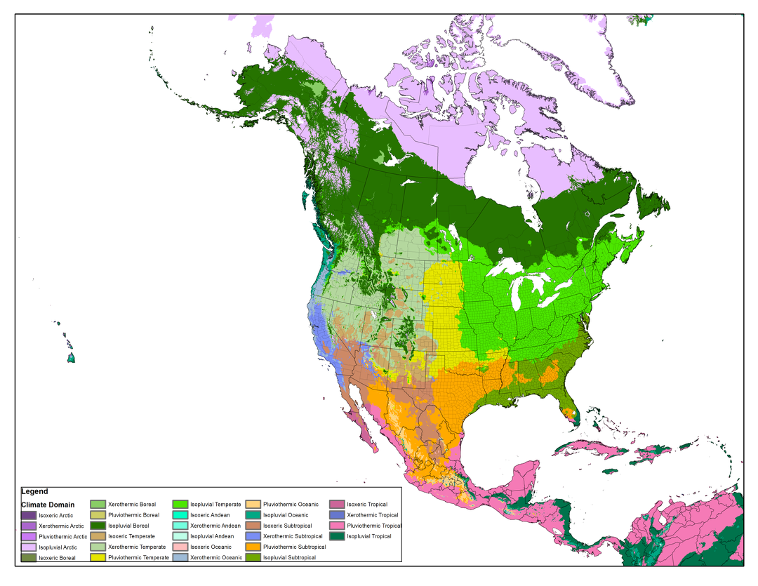
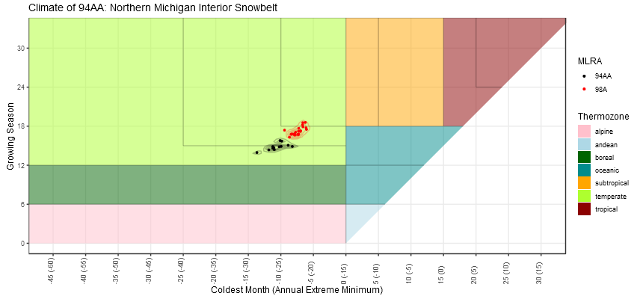
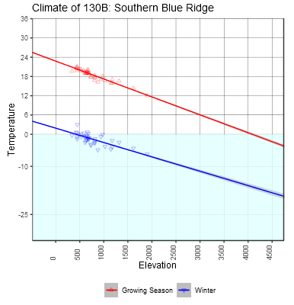
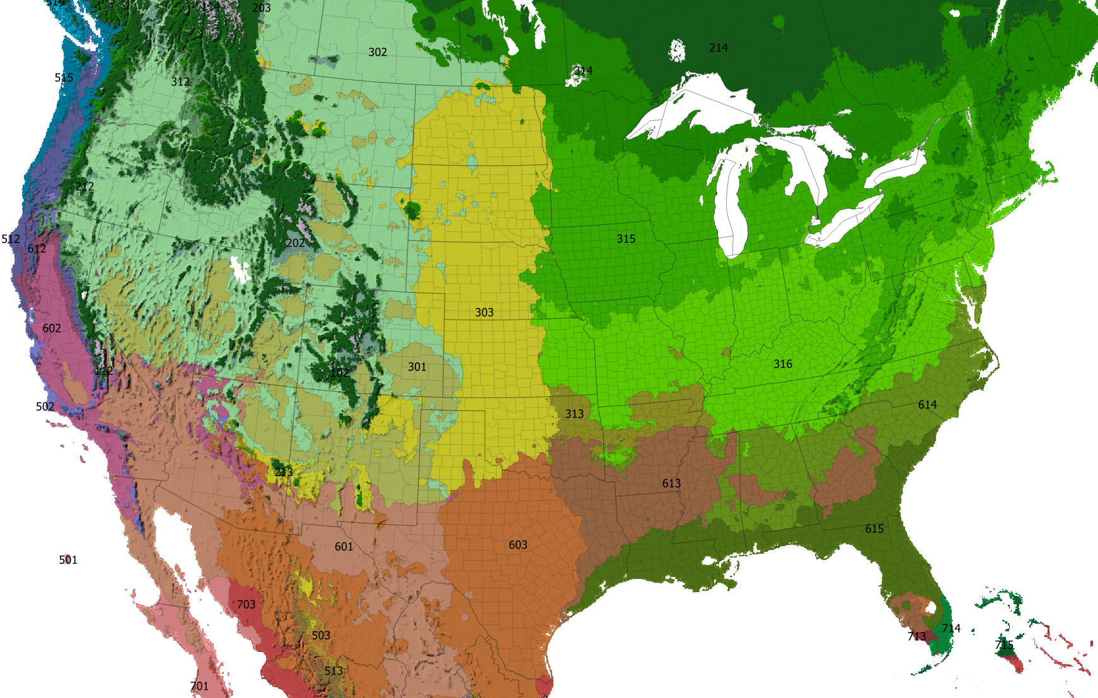
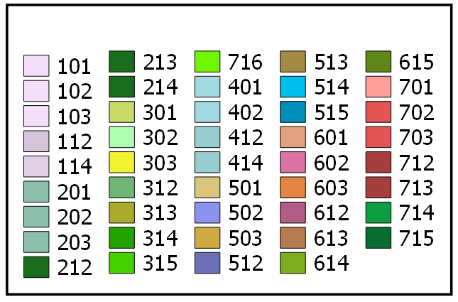

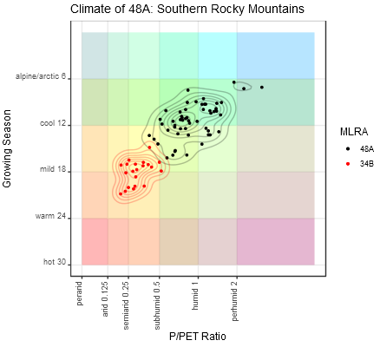
The Ecological Relevance of Parameter Choice in Describing Climate
Printing:
This poster is 48” wide by 36” high. It’s designed to be printed on a large-format printer.
NRCS Design Standards:
This template was designed to assist field staff to format technical posters that comply with USDA and NRCS visual standards.
Do not place any text, images, or logos in the USDA Isolation bar (Iso-bar). The USDA logo and signature must stand alone.
Select Your Poster Format:
To start creating your poster, choose one of the 10 slide formats from the left panel, and then delete the other remaining nine slides. Save as a PowerPoint presentation and rename the file to preserve the template for future use.
Customizing the Content:
Click on the Insert tab to add pictures, shapes, charts, text, etc.
Be sure to keep your content within the vertical and horizontal guides.
NRCS preferred fonts: Gotham, Arial, and Times New Roman
Climate is an important factor in determining the broad patterns of species distribution and potential vegetation. But when similar or adjacent sites with similar soils are compared, it is not clear what if any difference in climate is responsible for differences in site potential. Ecological site descriptions commonly feature monthly and annual precipitation and temperature in climate descriptions and graphs. However, there is wide overlap among these parameters even where temperature and moisture are the primary drivers for the differences among vegetation types.
I propose several different parameters which have a better relationship to vegetation differences. Available moisture can only be determined when the timing of the inputs of precipitation and the outputs of potential evapotranspiration (PET) are considered with respect to growing season. Temperature can be understood both terms of optimal physiological activity, and lethal tissue limitations. The proposed parameters retain a connection to real world measurement units and are not obscure unitless indices derived from complex relationships. A Shiny application was developed to illustrate alternative graphs with which to compare different regions of the country. Maps were produced to illustrate the distribution of suggested classification intervals of the parameters.
Seven climate indices were calculated to provide a base for an alternative climate classification and be physiologically informative for plant distribution modeling. The indices retain in real world units that can be directly related to climate change. The larger categories of the classification approximate major vegetation formations, but the indices can be subdivided into smaller, regular increments without the presumption that any given threshold implies precision in interpretation.
**Growing Season Temperature** is the positive average temperature of the warmest 6 months (any sub-freezing months are counted as zeros). Körner (1998) demonstrated that the cold limits of forest growth across a wide range of latitudes share a growing season temperature of 6 to 7°C.
Previous attempts at pinning timberline to a highest monthly mean temperature of 10°C (e.g. the Köppen-Geiger system, Kottek et al, 2006), and Holdridge’s (1947) mean annual biotemperature of 3°C are most successful if applied only to middle and high latitudes. But in tropical mountains, where the annual range in monthly temperature is small, the highest forests grow where maximum monthly mean temperatures and annual mean temperatures converge toward 6°C. This temperature threshold can be realized at higher latitude timberlines simply by calculating the positive temperature for the warmest six months, instead of for the whole year.
**Annual Extreme Low & Coldest Mean Monthly Temperature**
Cold temperature effects vegetation in two ways; it can simply be too cold for metabolic activity or it can damage tissues. The capability of evergreens to remain functional at a lower temperature must be balanced with the risk of damage by even colder temperatures or the loss in efficiency at warmer temperatures. Mean monthly temperature below freezing offers little advantage to an evergreen and risks desiccation due to frozen soils. Therefore, most evergreens in the temperate zone have thickened needle and scale leaves with small surface areas to avoid damage.
Where the coldest monthly means remain above freezing, broadleaf evergreen vegetation can be supported. However, most broadleaf evergreens, such as those found in subtropical climates, are damaged by where temperatures drop below -15°C Prentice et al, (1992) and Box (1996). Tropical vegetation is nearly intolerant of any freezing temperatures, and in some cases can be damaged by cold a few degrees above freezing.
The synthesis of extreme cold and average cold into a single index, offset by 15 degrees, was made to emphasize the effects of winter extremes in the continental northern hemisphere, while focusing on metabolic limitations where extreme temperatures are lacking in oceanic southern hemisphere.
**P/PET Ratio**
Mesophytic vegetation requires a constant supply of soil moisture, whereas xerophytic vegetation tolerates periods of drought. Mesophytic forests typically occur where mean annual precipitation exceeds potential evapotranspiration ratio (P/PET ratio), meaning that seasonal dry periods are more than compensated for by seasonal surpluses stored as soil moisture to maintain plant growth. Gradations in moisture regime are usually expressed on a log base 2 scale (e.g. Holdridge), from per-humid and per-arid at its wet and dry extremes respectively.
**Surplus & Deficit**
Even in a humid climate, significant seasonal drought occurs where the cumulative loss of moisture evapotranspiration exceeds that of available soil water holding capacity within the rooting zone. A deficit of 150 mm or more is considered significant for most soils and would require adaptations of thickened leaves or deciduousness to protect a plant from drying out. Desert vegetation may occur where precipitation is less than half required to maintain soil moisture, and that significant seasonal surpluses do not support seasonal growth of mesophytic vegetation. Instead, desert vegetation must avail themselves with episodic rainfall that never wets the whole soil profile.
![Figure 3: Comparision between a humid isopluvial climate (MLRA 98A) and a perhumid xerothermic climate (MLRA 1), showing that significant moisture stress can be more likely in the wetter climate if soil water holding capacity is less than the total moisture deficit.](figures/MoistureDroughtCompare.png)
**Peak AET** For climates with seasonal variability in moisture, plants must employ a strategy of either tolerance or avoidance to survive the dry season. The timing of the dry season, however is of less importance compared the timing of the wet season. If the wet season coincides with temperatures favoring maximum growth, the strategy is avoidance, allowing annual regrowth of more efficient deciduous organs optimized for higher peak productivity. In contrast, if moisture is only available during periods of lower temperatures, the strategy is tolerance, allowing persistence through long periods of low productivity. In addition, when warm temperatures coincides with precipitation, the frequency of lightning is higher and fire return inverval is shorter, further giving advantage to grassland vegetation over shrubland.
Actual monthly evapotranspiration (AET) is an indicator of how much precipitation of the current month is used in that month. A minimally tropical month at 15°C would generally result in a PET of at least 75 mm. Therefore, a tropical rainy should have a peak monthly AET of greater than or equal to 75 mm. Plants in seasonally moist climates with peak AET less than 75 mm either lack a warm season, or are moist only during the cool season.
![Figure 4: Comparision between a subtropical prairie climate (MLRA 78A) and a chapparal climate (MLRA 14), showing how peak AET is the key difference.](figures/pAET_Compare.png)
**A note on estimating annual extreme low temperatures** Most available climatic data sets consist of averaged monthly values and lack sufficient information on temperature extremes. In order to estimate annual extreme low temperature, I consulted a couple of sources (Magarey, Borchert, & Schlegel, 2008; Daly et al., 2012) which generated gridded hardiness zone data. I then sampled points from these grids to associate with mean monthly temperature parameters from another gridded source of the appropriate timeframe
(Hijmans et al., 2005; Daly et al., 2008) and developed a linear model. The linear model related annual extreme low temperatures with mean daily low temperatures, latitude, and altitude. I refined the model further by introducing a set of regional correction factors based on distance from specific latitudes and longitudes.
**A note on PET equations** Potential evapotranspiration is a function of temperature, solar radiation, relative humidity, cloud cover, wind speed, and atmospheric pressure (Lu, McNulty, & Amatya, 2005). The Holdridge method is the simplest method, by simply multiplying annual biotemperature by 58.93, but is never used for serious applications beyond climate classification. The Thornthwaite method was an earlier attempt at estimating PET that used only monthly mean temperature, and used day length as a proxy for solar radiation. Formulas that use daylength for solar radiation that do not account for lower sun angles (e.g. Thornthwaite) may also over estimate PET at high latitudes with 24 hour sunshine. The interpretability monthly values using the Thorntwaite method is also complicated by division by a “heat index” which is based on an annual temperature total, rendering some values in the arctic region to be anomalously high. Priestly-Taylor method is considered among the more accurate (Lu, McNulty, & Amatya, 2005), consisting of elements of each of these factors (Details can be found here: http://www.fao.org/docrep/x0490e/x0490e07.htm#solar%20radiation or http://modeling.bsyse.wsu.edu/CS_Suite/cropsyst/manual/simulation/et/priestly_taylor.htm). Employing all the needed parameters for a global map is impracticable. Hargreaves-Samoni method reduces the number of required parameters by using daily temperature range as a proxy for cloud cover and relative humidity. I followed a hybrid approach using temperature, daily temperature range, and a formula for calculating shortwave solar radiation. I calibrated the formula against values from the Thornthwaite method in the north temperate zone where it is widely employed. This approach falls short of the Thornthwaite method in cool or humid climates and exceeds it in arid regions with a wide daily temperature ranges.
Natural Resources Conservation Service l Soil and Plant Science Division l nrcs.usda.gov/soils

